Slide 1
bkggeocoder: a geocoding tool for survey data
Meet the Experts – GESIS online talks
Augmenting survey data by linking and harmonization
Dr. Stefan Jünger, 13th April 2023

Slide 2

Speaker
Picture?
Dr. Stefan Jünger
Senior Researcher, Deputy Head of the Team Survey Data Augmentation
At GESIS since 2013, Dr. rer. pol. University of Cologne
Research interests: political & environmental attitudes, georeferencing, open science
Contact: stefan.juenger@gesis.org

Slide 3

Space & place – an old hat?
Has been a topic already for a long time
incorporated into classic theories, e.g., Allport‘s Contact Theory (1954)
Subject of Urban Studies, regional sociology, and environmental social sciences
https://i.gr-assets.com/images/S/compressed.photo.goodreads.com/books/1387595670l/7034925.jpg

Slide 4
From the past to today (in sociology)
Qualitative and theoretical work is manifold (Cronin-de-Chavez et al. 2019; Mullis 2019; Förtner et al. 2021)
Many regionally focused studies
Difficult to translate to…
Aschauer 2021
…quantitative research
Space often defined by data (Petrović et al., 2019; Kruse & Teltemann 2022)
  e.g., administrative borders
  Neighborhood as ‘container’
Baur et al. 2014

Slide 5







Data landscape today
Increased amount of available data
Better tools
Personal computers with enough horsepower
Standard software, such as R, can be used as Geographic Information System (GIS)

Slide 6
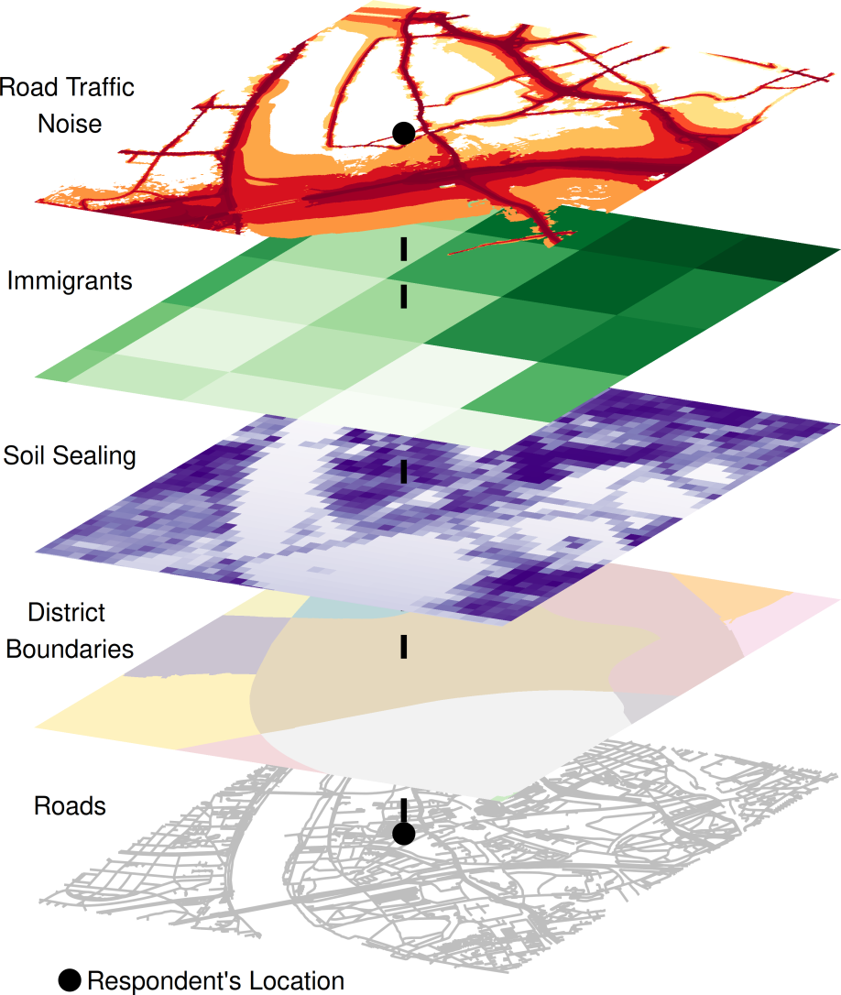
Georeferencing & spatial linking
Data enriched with geo-coordinates
Enable…
Projection in one space
Linking based on same or geographically related localities
OpenStreetMap / GEOFABRIK, 2018, City of Cologne, 2014, Leibniz Institute of Ecological Urban and Regional Development, 2018, Statistical Offices of the Federation and the Länder, 2016, and German Environmental Agency / EIONET Central Data Repository, 2016 / Jünger, 2019

Slide 7
Georeferencing @GESIS
Linking of ALLBUS with environmental noise and German Census 2011 data (DFG project „GeorefUm“,
2015-2017)
Start of „GRETA“ project (H2020, 2021-2023)
Start of „SoRa+“ project (DFG, 2023-2026)
Development of services for external users
Start of „SoRa“ project (DFG, 2017-2020)
Streamlining of services/tools
Start of „GxC“ project (internal, 2023-2025)
Georeferencing of GESIS studies
2016
2017
2018
2019
2020
2021
2022
2023

Slide 8
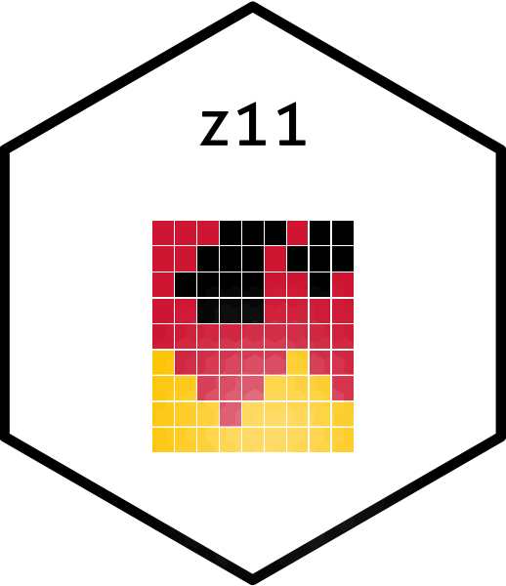





Georeferencing @GESIS
Georeferencing of GESIS studies
Development of services for external users
Streamlining of services/tools
2016
2017
2018
2019
2020
2021
2022
2023

Slide 9
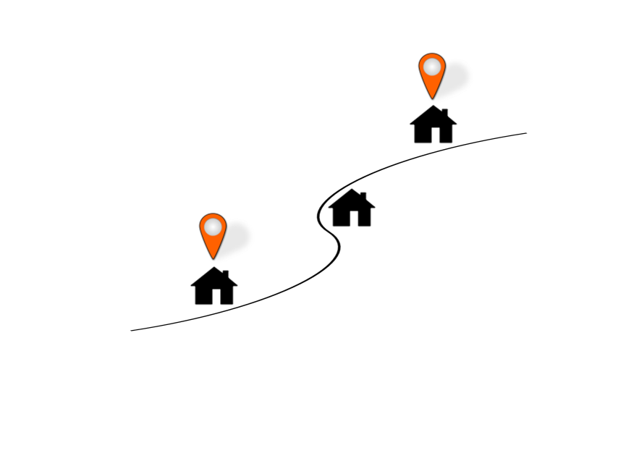
Geocoding
Converting indirect spatial references into direct spatial references
→ Addresses to geo-coordinates
Different service providers
can be used
e.g., Google, Bing, OSM
In Germany: Federal Agency of Cartography and Geodesy (BKG)

Slide 10

R package: bkggeocoder
Access to BKG geocoding API and address database
Can be used online & offline
Provides more than ‘just’ geocoordinates
Developed by
Stefan Jünger: https://github.com/StefanJuenger
Jonas Lieth: https://github.com/JsLth

Slide 11
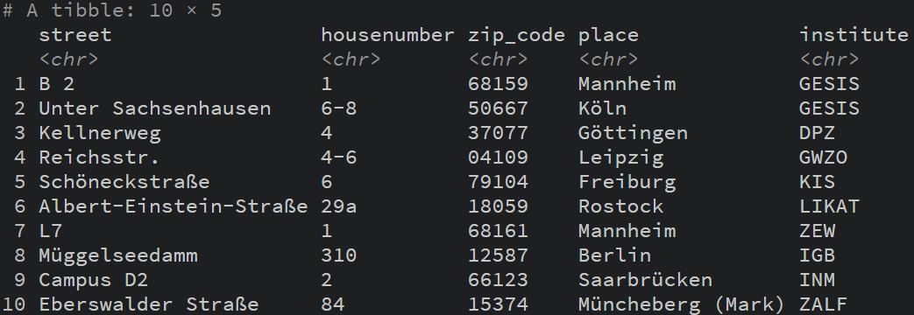
Addresses: Leibniz institutes

Slide 13
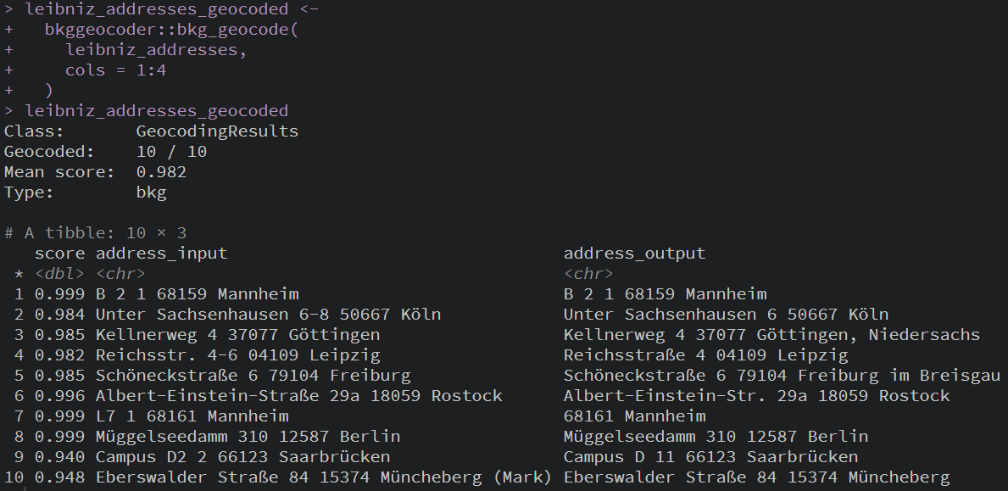
Using bkg_geocode() (BKG API access)

Slide 14
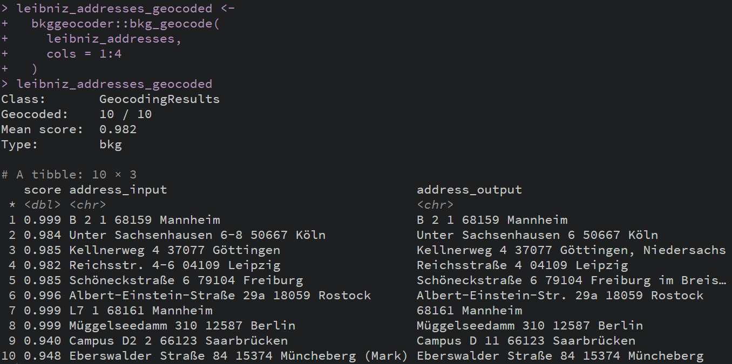

Slide 15
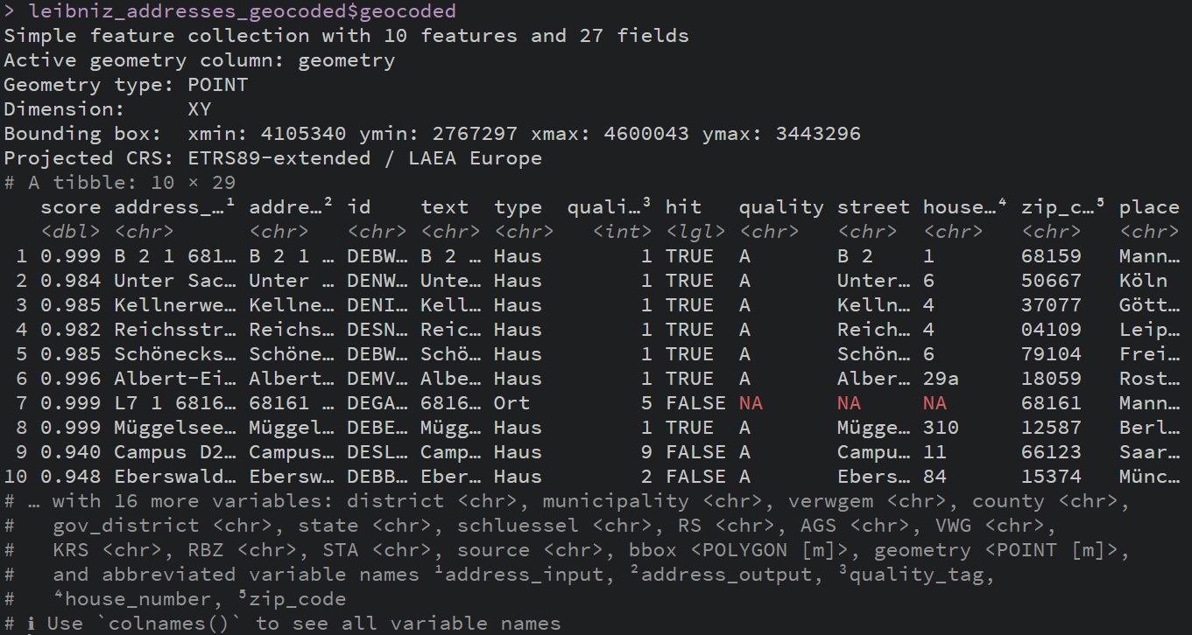
More than just geocoordinates

Slide 17
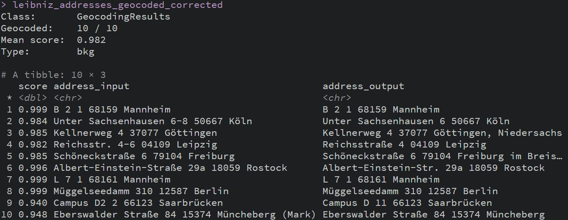
Using edited addresses

Slide 19
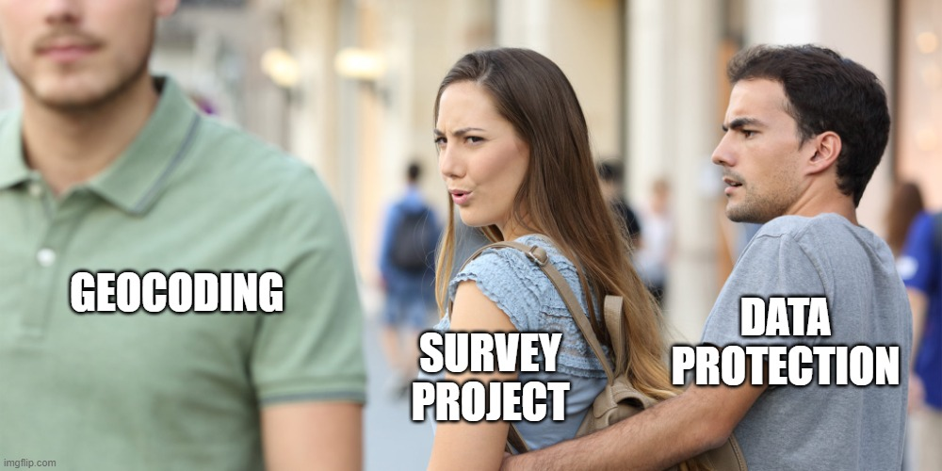

Slide 20
Some project contexts may not allow online geocoding due to missing informed consent…
…we developed an offline
geocoder for these cases

Slide 21
Offline geocoder architecture
(Survey)
addresses
Group by
zip code / place combinations
Record linkage
I
BKG address database
Step 1

Slide 22
Offline geocoder architecture
(Survey)
addresses
Group by
zip code / place combinations
Record linkage
I
BKG address database
Step 1
Extract street and house number (grouped)
Record linkage
II
Address excerpt
(grouped)
Step 2

Slide 23
Offline geocoder architecture
(Survey)
addresses
Group by
zip code / place combinations
Record linkage
I
BKG address database
Step 1
Extract street and house number (grouped)
Record linkage
II
Address excerpt
(grouped)
Step 2
Data cleaning
Geocoded (survey) data
Step 3

Slide 24
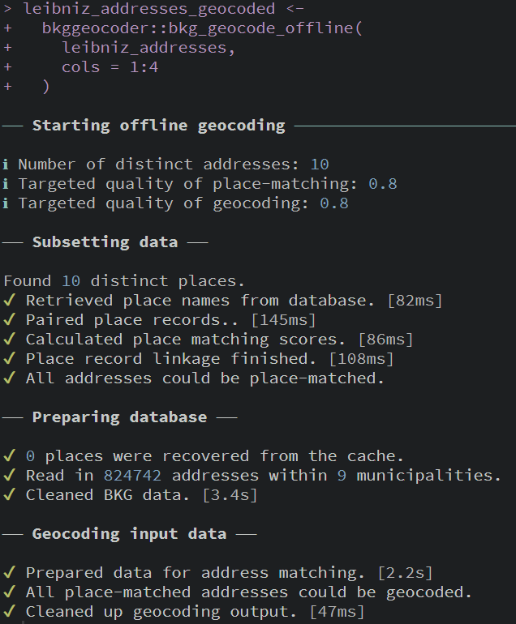
Using bkg_geocode_offline()

Slide 26
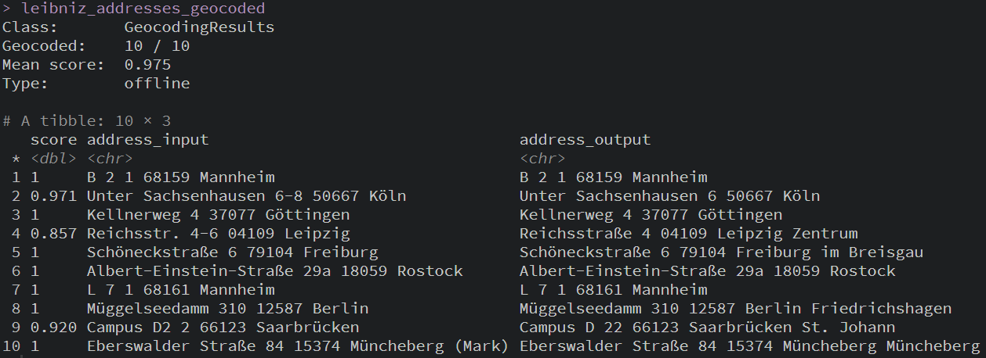
Using bkg_geocode_offline()

Slide 28
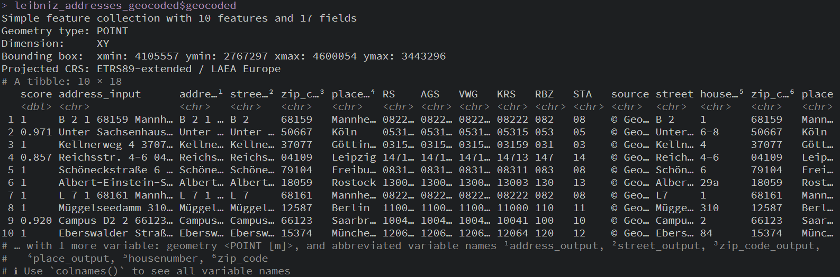
Again, more than just geocoordinates

Slide 30
Accessing the tool
bkggeocoder is written as an R package:
It‘s open source - install it with: remotes::install_github(„StefanJuenger/bkggecoder“)
https://github.com/StefanJuenger/bkggeocoder
Yet, you may not be able to use all functions
A BKG license is required
Hence, talk to us

Slide 31
Geocoding is the most important prerequisite to get started with georeferenced (survey) data
Has to be based on data with a high quality
We developed a straightforward tool to base your geocoding on official adminstrative data
It respects survey respondents‘ privacy!

Slide 32
Future plans & role in georeferencing services
Interoperability and integration with other data services/tools, e.g.,
Routing (ORSRouting package)
Other geospatial data (e.g., BKG Points of Interest)
Geocoding is at heart of all georeferencing endevours
Mean to an end, not end in itself
Our main target is access to georeferenced data
2030
…
2024

Slide 33

More on georeferenced data & data linking
Anne-Kathrin Stroppe‘s talk on the georeferenced GLES: https://www.youtube.com/watch?v=zJCldWEqhac
Sebastian Ziaja‘s and Pascal Siegers‘ talk on data linking: https://www.youtube.com/watch?v=yfdBrotxcv8
Our course on using geospatial data in R: https://training.gesis.org/?site=pDetails&pID=0x0AC9B5CFBFFF4FE4B870D4DC61F5FD77
https://pixabay.com/de/photos/kinder-schule-emotionen-globus-2835430/

Slide 34
References
Allport, G. W. (1954). The Nature of Prejudice. Addison-Wesley Publishing Company.
Aschauer, W. (2021). The Re-Figuration of Spaces and Comparative Sociology: Potential New Directions for Quantitative Research.
Baur, N., Hering, L., Raschke, A. L., & Thierbach, C. (2014). Theory and Methods in Spatial Analysis. Towards Integrating Qualitative, Quantitative and Cartographic Approaches in the Social Sciences and Humanities. Historical Social Research, 39(2), 7–50. https://doi.org/10.12759/hsr.39.2014.2.7-50
Cronin-de-Chavez, A., Islam, S., & McEachan, R. R. C. (2019). Not a level playing field: A qualitative study exploring structural, community and individual determinants of greenspace use amongst low-income multi-ethnic families. Health & Place, 56, 118–126. https://doi.org/10.1016/j.healthplace.2019.01.018
Förtner, M., Belina, B., & Naumann, M. (2021). The revenge of the village? The geography of right-wing populist electoral success, anti-politics, and austerity in Germany. Environment and Planning C: Politics and Space, 39(3), 574–596. https://doi.org/10.1177/2399654420951803
Jünger, S. (2019). Using Georeferenced Data in Social Science Survey Research. The Method of Spatial Linking and Its Application with the German General Social Survey and the GESIS Panel. GESIS - Leibniz-Institut für Sozialwissenschaften. https://doi.org/10.21241/ssoar.63688
Kruse, H., & Teltemann, J. (Hrsg.). (2022). Differenz im Raum: Sozialstruktur und Grenzziehung in deutschen Städten. Springer Fachmedien Wiesbaden. https://doi.org/10.1007/978-3-658-35009-3
Mullis, D. (2019). Urban conditions for the rise of the far right in the global city of Frankfurt: From austerity urbanism, post-democracy and gentrification to regressive collectivity. Urban Studies, 58(1), 131–147. https://doi.org/10.1177/0042098019878395
Park, R. E., Burgess, E. W., & McKenzie, R. D. (1925). The City. Suggestions for Investigation of Human Behavior in the Urban Environment. University of Chicago Press.
Petrović, A., Manley, D., & van Ham, M. (2019). Freedom from the tyranny of neighbourhood: Rethinking sociospatial context effects. Progress in Human Geography, 44(6), 1103–1123. https://doi.org/10.1177/0309132519868767

Slide 35

Expert contact & GESIS consulting
Contact: you can reach the speaker via e-mail:
stefan.juenger@gesis.org
GESIS Consulting: GESIS offers individual consulting in a number of areas – including survey design & methodology, data archiving, digital behavioral data & computational social science – and across the research data cycle.
Please visit our website www.gesis.org for more detailed information on available services and terms.

Slide 36
Upcoming talks
Please visit our meet-the-experts website:
  https://www.gesis.org/en/services/sharing-knowledge/consulting-and-guidelines/meet-the-experts
  11-05-2023, Dr. Silke Schneider & Lennart Palm, Socio-demographic variables in surveys: increasing research potential through output harmonisation (in Deutsch)
  01-06-2023, Dr. Markus Quandt & Ivet Solanes Ros, „Ex Post-Harmonised“ and Cumulated Comparative Survey Data Files at GESIS – and What to Expect Of Them (in English)
  13-07-2023, Gender-sensitive language in surveys – yes, no, to a certain degree (Panel discussion in German)

Slide 37
Thank you for participating!

